Slide 1



New geospatial methods for the second-dimension spatial association
Yongze Song
PI, Senior Lecturer, Curtin University

Slide 2
Introduction
Data Description
Methodology
Flowchart of Analysis
Working Plans
References
Contacts

Slide 3
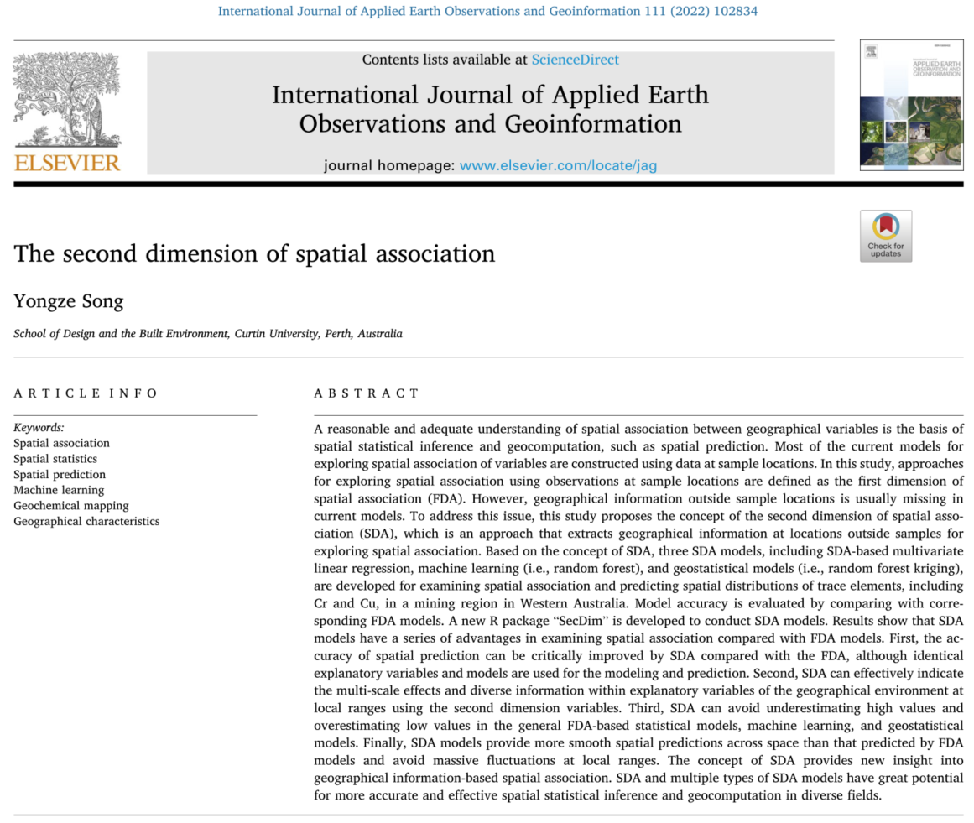
Introduction
Background
A reasonable and adequate understanding of spatial association between geographical variables is the basis of spatial statistical inference and geocomputation, such as spatial prediction. Most of the current models for exploring spatial association of variables are constructed using data at sample locations, lacking geographic information outside the sample locations.
Objectives
This project aims at developing a new geospatial method based on the concept of the second-dimension spatial association for more accurate spatial prediction.
Yongze Song (2022) The second dimension of spatial association, International Journal of Applied Earth Observation and Geoinformation, 111, 102834, DOI: 10.1016/j.jag.2022.102834

Slide 4
Data Description
Data Sources
Geological Survey of Western Australia(GSWA)
Geosciences Australia
Main Roads Western Australia
Data Files
Geochemistry data
Australian Smoothed Digital Elevation Model
GEODATA TOPO 250 K Series 3 data set
MOD13Q1.006
Soil and Landscape Grid of Australia
Road network data

Slide 5
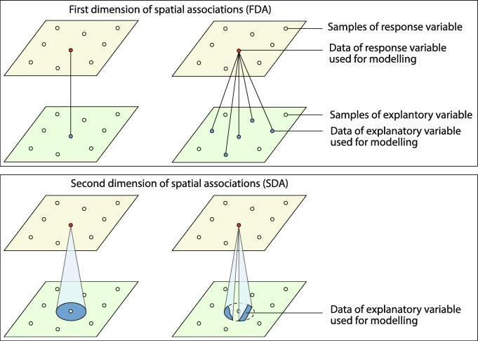
Methodology
Concept of the second dimension of spatial association (SDA)
The second dimension of spatial association (SDA ) is an approach that extracts in-depth information about the geographical environment from locations outside sample points or spatial units of observations to explore spatial association.
Comparison of concepts of the first and the second dimensions of spatial association (FDA and SDA)

Slide 6
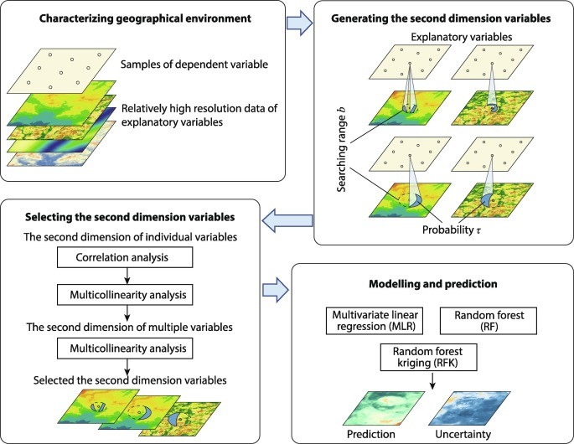
Flowchart of Analysis
SDA models
Based on the concept of SDA, three SDA models, including SDA-based multivariate linear regression, machine learning (i.e., random forest), and geostatistical models (i.e., random forest kriging).
Schematic overview of the second dimension model (SDM) for assessing spatial association

Slide 7
Working Plans
The work plan of SDM in predicting spatial distributions of trace elements is as follows.
Explanatory variables are collected from remote sensing data and geospatial analysis to characterize the geographical environment.
SDMs are implemented in modeling relationships between trace elements and data of explanatory variables outside sample locations.
The modeling accuracy is evaluated using cross-validation and compared with FDA models.
The relationships between trace elements and data of explanatory variables outside sample locations explored by SDMs are used for spatial prediction, and the prediction uncertainty and effectiveness are evaluated.
The study will generate an article to be published on a top GIS journal.

Slide 8
References
Yongze Song (2022) The second dimension of spatial association, International Journal of Applied Earth Observation and Geoinformation, 111, 102834, DOI: 10.1016/j.jag.2022.102834
Department of Mines, Industry Regulation and Safety, Government of Western Australia, 2022. Gswa geochemistry. https://www.dmp.wa.gov.au/GeoChem-Extract-Geochemistry-1559
Geoscience Australia, 2006. Geodata topo 250k series 3. https://ecat.ga.gov.au/geonetwork/srv/eng/catalog.search#/metadata/63999
Didan, K., 2015. Mod13q1 modis/terra vegetation indices 16-day l3 global 250m sin grid v006. nasa eosdis land processes daac. https://developers.google.com/earthengine/datasets/catalog/MODIS_006_MOD13Q1
Viscarra Rossel, R., Chen, C., Grundy, M., Searle, R., Clifford, D., Odgers, N., Holmes, K., Griffin, T., Liddicoat, C., Kidd, D., 2014. Soil and landscape grid national soil attribute maps - soil attribute release 1. v2. https://developers.google.com/earth-engine/datasets/catalog/CSIRO_SLGA
Main Roads Western Australia, 2020. Road network in western australia. https://catalogue.data.wa.gov.au/sv/dataset/mrwa-road-network

Slide 9
Contacts

